Slide 1

Gateway Elementary
SW-PBS Matrix

Slide 2
How We Behave At Gateway | On the Bus | In the Hallways | In the Classroom | In the Restroom | In the Cafeteria | All Settings
Be Respectful | 1. Listen and follow the driver’s directions. 2. Use school-appropriate language. | 1. Walk 2. Stay in a single-file line. 3. Pay attention to your teacher.* | 1. Raise your hand and wait to be called on. 2. Be an active listener. | 1. Respect others’ privacy. 2. Use the restroom in a timely manner. | 1. Use please and thank you when speaking to café staff. | 1. Use kind words and actions. 2. Use school materials the way they were intended to be used.
Be Responsible | 1. Go to your bus room quickly and on time. 2. Keep the bus clean. | 1. Maintain your place in line. | 1. Come prepared with supplies and work. | 1. Wash your hands before leaving the restroom. 2. Clean up after yourself. | 1. Clean up after yourself and throw away all of your trash. 2. Learn your lunch PIN number. | 1. Follow directions the first time they are given. 2. Work cooperatively with others.
Use Self-Control | 1. Stay in your own seat at all times. 2. Use voice level 2. | 1. Walk at a steady pace on the right side of the hallway. 2. Watch your step and face forward. 3. Use voice level 0. | 1. Come into the classroom quietly and orderly. 2. Use voice level 0-3, depending on the activity. | 1. Wait patiently to use the next stall or sink. 2. Use voice level 0. | 1.Stay in assigned seat with feet on floor 2. Stand in line and wait patiently to be served. 3. Use voice level 2 at all times. | 1. Keep your hands, feet, and objects to yourself. 2. Use the appropriate voice level in each location.

Slide 3

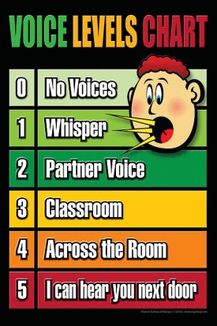


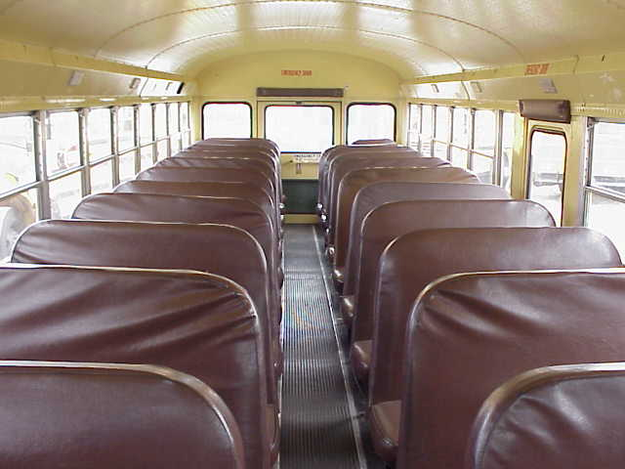

How we behave at Gateway….
 | On the Bus | All Settings
Be Respectful | Listen and follow the driver’s directions. Use school-appropriate language | Use kind words and actions. Use school materials the way they were intended to be used.
Be Responsible | Go to your bus room quickly and on time. Keep the bus clean. | Follow directions the first time they are given. Work cooperatively with others.
Use Self-Control | Stay in your own seat at all times. Use voice level 2. | Keep your hands, feet, and objects to yourself. Use the appropriate voice level in each location.

Slide 4



How we behave at Gateway….
 | In the Hallways | All Settings
Be Respectful | Walk Stay in a single-file line. Pay attention to your teacher* | Use kind words and actions. Use school materials the way they were intended to be used.
Be Responsible | Maintain your place in line. | Follow directions the first time they are given. Work cooperatively with others.
Use Self-Control | Walk at a steady pace on the right side of the hallway. Watch your step and face forward. Use voice level 0. | Keep your hands, feet, and objects to yourself. Use the appropriate voice level in each location.
*Teachers will model voice level 0.

Slide 5



How we behave at Gateway….
 | In the Classroom | All Settings
Be Respectful | Raise your hand and wait to be called on. Be an active listener. | Use kind words and actions. Use school materials the way they were intended to be used.
Be Responsible | Come prepared with supplies and work. | Follow directions the first time they are given. Work cooperatively with others.
Use Self-Control | Come into the classroom quietly and orderly. Use voice level 0 – 3, depending on the activity. | Keep your hands, feet, and objects to yourself. Use the appropriate voice level in each location.

Slide 6

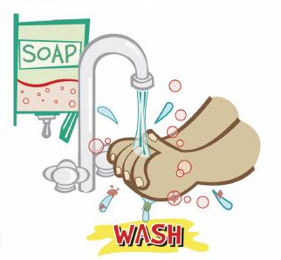


How we behave at Gateway….
 | In the Restroom | All Settings
Be Respectful | Respect other’s privacy. Use the restroom in a timely manner. | Use kind words and actions. Use school materials the way they were intended to be used.
Be Responsible | Wash your hands before leaving the restroom. Clean up after yourself. | Follow directions the first time they are given. Work cooperatively with others.
Use Self-Control | Wait patiently to use the next stall or sink. Use voice level 0. | Keep your hands, feet, and objects to yourself. Use the appropriate voice level in each location.

Slide 7




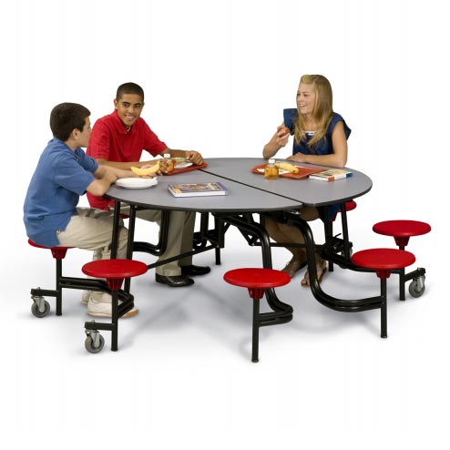

How we behave at Gateway….
 | In the Cafeteria | All Settings
Be Respectful | Use please and thank you when speaking to the café staff. | Use kind words and actions. Use school materials the way they were intended to be used.
Be Responsible | Clean up after yourself and throw away all of your trash. Learn your lunch PIN number. | Follow directions the first time they are given. Work cooperatively with others.
Use Self-Control | Stay in assigned seat with feet on the floor. Stand in line and wait patiently to be served. Use voice level 2 at all times. | Keep your hands, feet, and objects to yourself. Use the appropriate voice level in each location.

Slide 8
Gateway Elementary
SW-PBS Matrix

